Slide 1

Financial Cash Flow Analysis
By Nikhil Sukhdev

Slide 2
Introduction
Given the financial records of the last 3 years, a thorough analysis has been performed.
Various accounts, expenses, and sources of revenue have been dissected.
Insights pertaining to the cash flow have been extracted.

Slide 3

Some Headline Numbers
137 Accounts
2197 Customers
1156 Providers
17 Revenue Accounts
105 Expense Accounts
Net Profit/Loss: -$10.68M
2460 Delayed Payments (Expense Accounts)
8458 Delayed Payments (Revenue Accounts)
Average Net Profit Margin: -11.62%

Slide 4
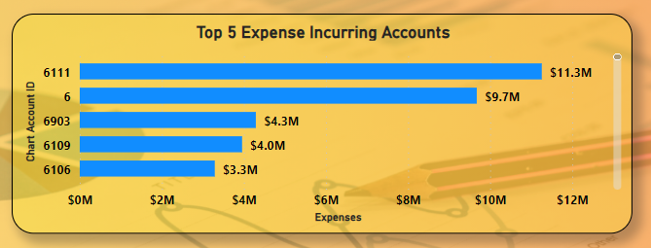
Insight 1:Account incurring the most expense
From the figure, it is seen that Account 6111 has generated the most amount of expenses at over $11M followed closely by Account 6.
This account comes under ‘Operational Expenses’ and the expense type is ‘Variable’.

Slide 5
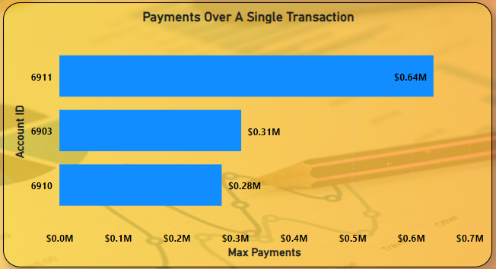
Insight 2: Account to which the highest amount has been paid to over a single transaction
The highest payment over a single transaction has been made by account 6911.
This account falls under the category of ‘Operational’ expenses and the expense type is ‘Variable’.
It seems that this account has been used to pay out loan related expenses.

Slide 6
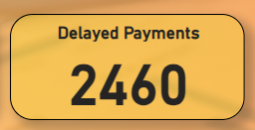
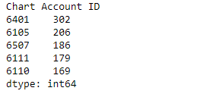
Insight 3: Number of delayed expense payments and the account which has the highest number of delayed payments
A total of 2460 delayed payments.
Account 6401 had the highest number of delayed expense related payments.
Account 6401 falls under the category of ‘Operational’ expenses and the expense type is ‘Fixed’.
This account has been used to allocating profits/dividends.

Slide 7
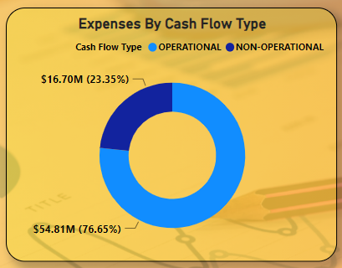
Insight 4: Distribution of money spent on operational/non-operational accounts
A significant proportion of money has been spent on ‘Operational Expenses’ as compared to ‘Non-Operational Expenses’.
Over 76% (~$55M) of the expenses constitute to ‘Operational’ expenses and approximately 23% (~$17M) of the expenses constitute to ‘Non-Operational’ expenses.

Slide 8
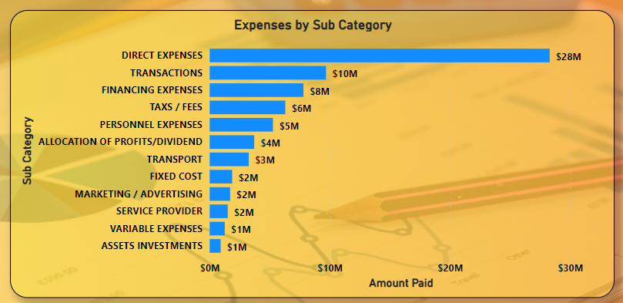
Insight 5: Distribution of expenses across various sub-categories
Direct expenses seem to be the source of highest expense generation.
Assets Investments on the other hand seem to be the least expense generating sub-category.

Slide 9
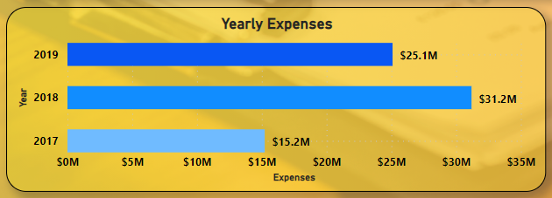
Insight 6: Expenditure By Year
From the graph seen, 2017 had the least expenditure and 2018 the highest.

Slide 10
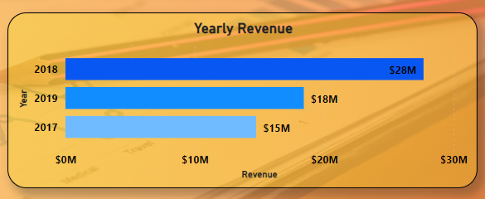
Insight 7: Income By Year
As per the graph, 2018 had the highest revenue and 2017 the lowest.
As 2018 was the year of highest income and expenditure, this could be touted as the year of ‘Highest Cash Flow’.
Similarly, 2017 could be touted as the year of ‘Lowest Cash Flow’.

Slide 11
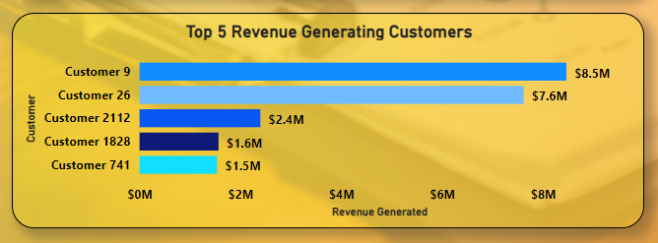
Insight 8: Top 5 revenue generating customers
Customer 9 has generated the highest revenue at $8.5M followed closely by Customer 26

Slide 12
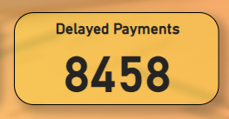
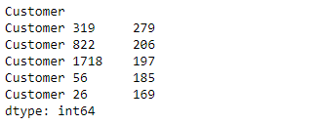
Insight 9: Number of delayed revenue payments and the customer who had the highest number of delayed payments
Customer 319 had the greatest number of delayed payments followed closely by Customer 288
~57% of the payments were settled late.

Slide 13
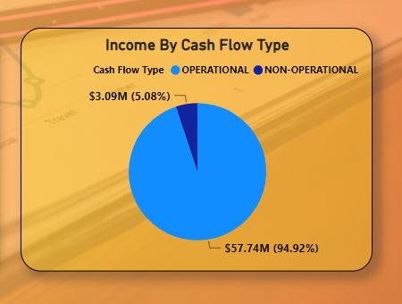
Insight 10: Distribution of income based on Operational/Non-Operational Accounts
A significant proportion of the income generated has been through ‘Operational’ accounts (~95%).

Slide 14
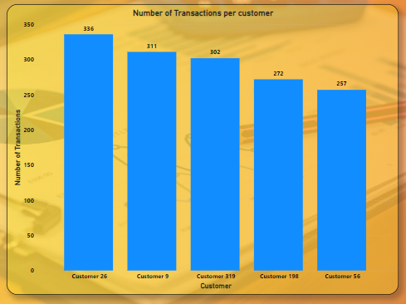
Insight 11: Top 5 customers who had the greatest number of income related transactions over the last 3 years
Customer 26 had the greatest number of transactions followed closely by customer 9 and customer 319 over the last 3 years.

Slide 15
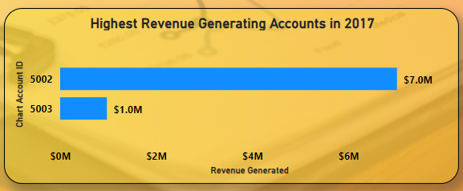
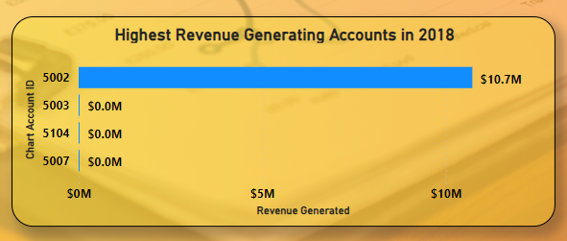
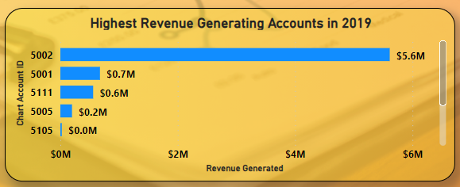

Insight 12: Identify the top 5 accounts which produced the highest income in years 2017, 2018, 2019
In 2017, account 5002 has generated the highest income.
In 2018, account 5002 has generated the highest income.
In 2019, account 5002 has generated the highest income.
5002 is the highest income generating account over the last 3 years.
This account generates ‘Operational’ revenue and deals with the provisioning of services.

Slide 16
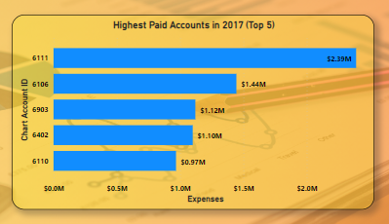
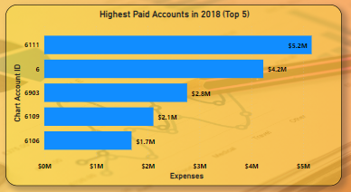
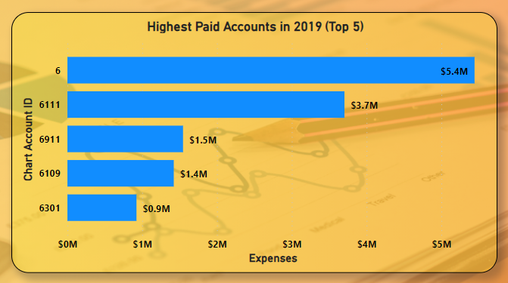
Insight 13: Identify the top 5 accounts to which the highest payments were made in 2017,2018, and 2019
In 2017 and 2018, account 6111 were the highest paid accounts
In 2019, account 6 was the highest paid account.
Account 6 is an account which deals with ‘Non-Operational’ expenses.
Account 6111 is an account dealing with the purchase of material for resale.

Slide 17
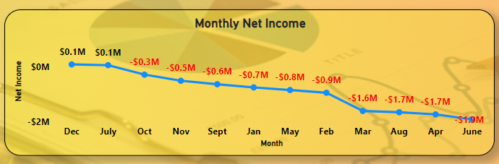
Insight 14: Monthly net-income
Over the last 3 years, profit has been shown only in the months of December and July.
The heaviest loss over the last 3 years has culminated in the month of June.

Slide 18
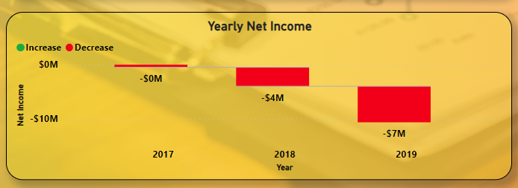
Insight 15: Yearly net-income
All 3 years have seen losses with 2019 being the year where the company suffered its heaviest loss

Slide 19
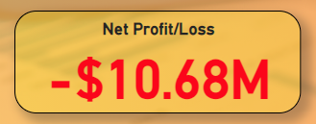
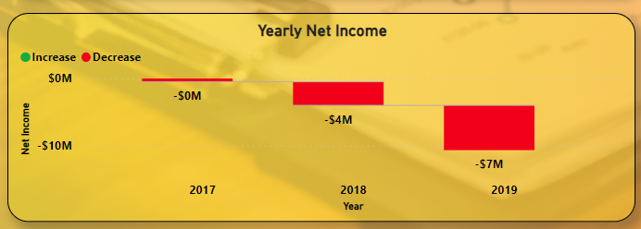
Insight 16: Overall Profit/Loss
The company over the last 3 years has accrued a loss of ~$11M with the losses increasing by each passing year.

Slide 20
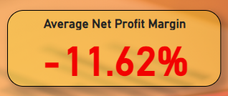
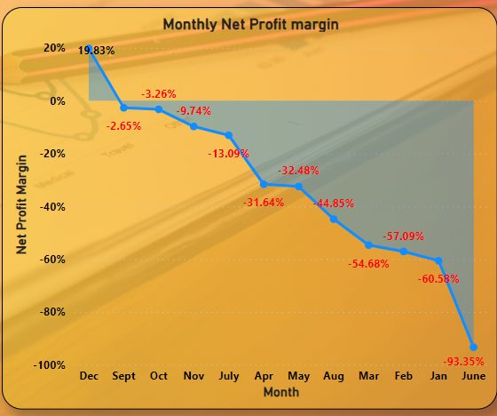
Insight 17: Net Profit Margin
On average, the company loses ~12 cents for every dollar of income generated.
Apart from December, where the company has made a cumulative profit of ~20 cents per dollar of revenue generated, all other months have shown losses.

Slide 21
Summary
The company has seen an overall loss of ~$11M over the last 3 years.
As a worrying trend, the losses seem to get higher with each passing year.
At the time of creating this report, the company loses ~12 cents for every dollar of revenue generated.
A significant proportion of the company’s money is spent towards ‘Operational’ expenses as compared to ‘Non-Operational’ expenses. A similar trend is seen in revenue generation too.
A whopping ~$28M has been spent on expenses tagged as ‘Direct Expenses’ which is significantly higher than the next highest sub-category ‘Transactions’ whose expenses constitute to ~$10M
Over the last 3 years, Account IDs 6111 and 6 have been the accounts incurring the highest expenses. Account 6111 is an account dealing with the ‘Purchase Of Material For Resale’. Account 6 is an account dealing with ‘Non-Operational’ expenses.
Provider 667 followed closely by Provider 1156 were the providers to whom the highest sum of payments were made over the last 3 years.
Over the last 3 years, December and July have been the only months where a cumulative profit has been observed. All other months have seen losses.
A whopping 8458 income related payments were settled late. This constitutes to over 57% of the payments being settled late.
Customer 9 has generated the highest income over the last 3 years followed closely by customer 26. However, customer 26 ranks 5th in the list of customers who had the greatest number of delayed payments.
Account 5002 has generated the highest revenue over the last 3 years. This account generated ‘Operational’ income and deals with the provisioning of services.

